Slide 1
Deep Learning of Humor from Gary Larson’s Cartoons
Robert Fischer, BSc.
TU Wien, Austria
Notes:
Do NOT mention Questions!

Slide 2
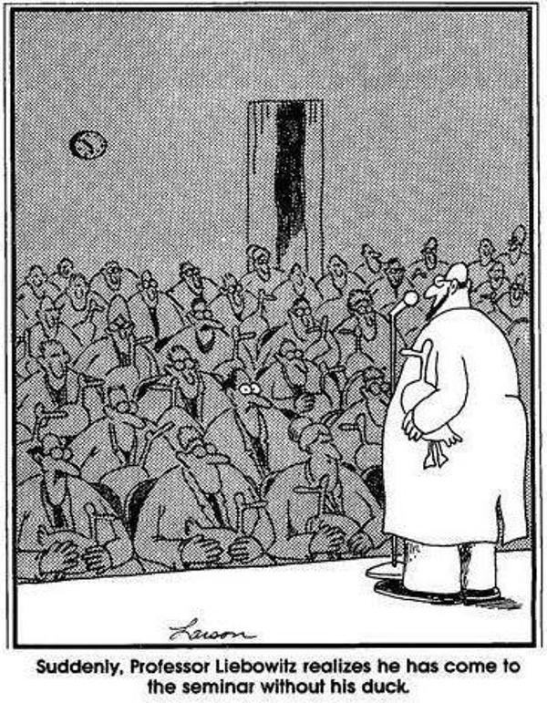
Contents
Gary Larson and his cartoons
Aim
Computational Humor
Dataset
Approaches
Results
Reproducibility
Conclusion

Slide 3
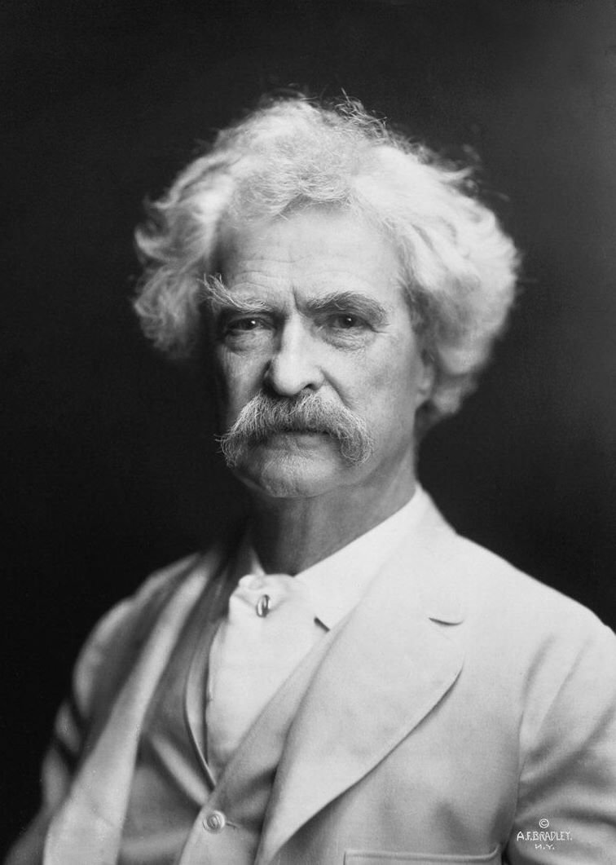
Humor
“Explaining humor is a lot like dissecting a frog, you learn a lot in the process, but in the end you kill it.”
– Mark Twain
Notes:
„as you can tell after seeing hundreds of cartoons“ Nur Zitat sagen, ohne viel erklärung

Slide 4
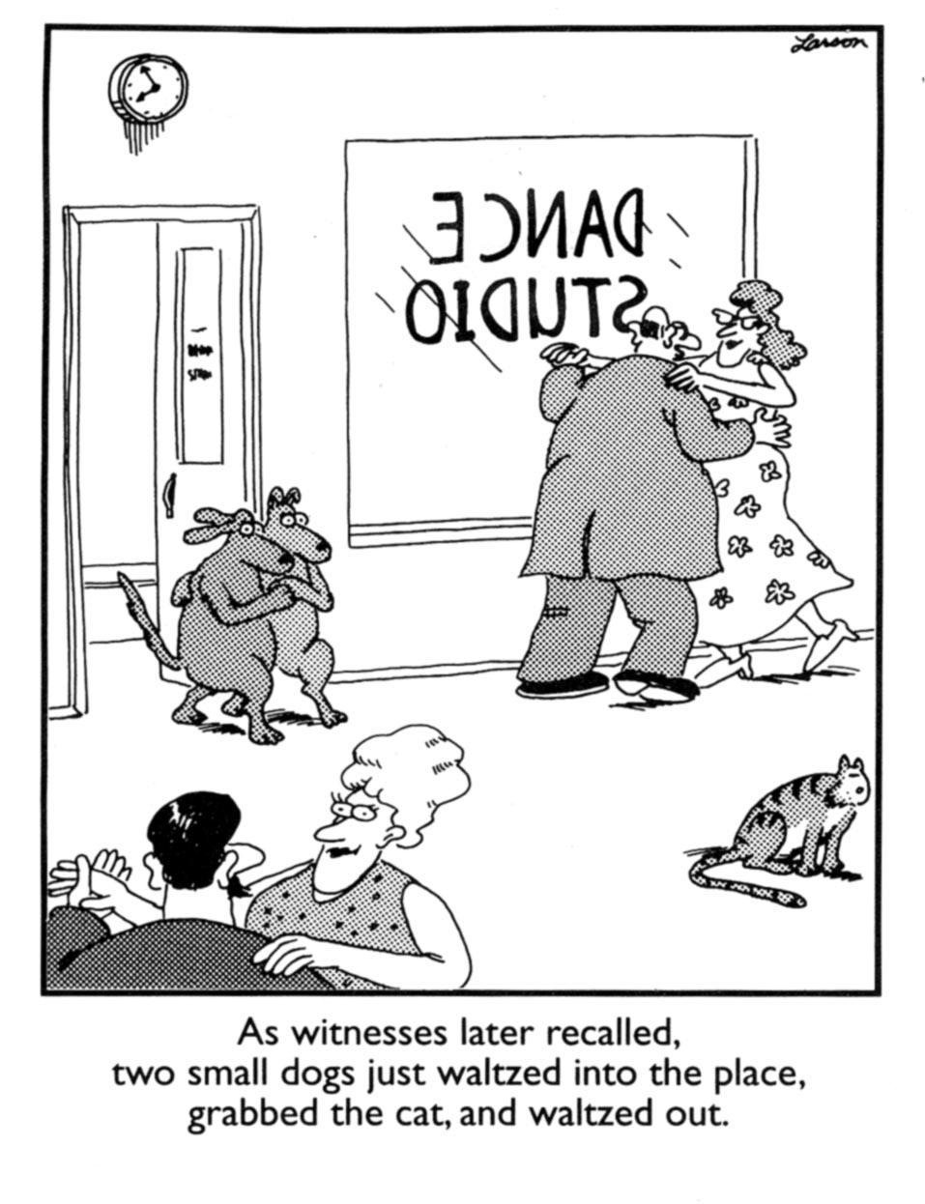
Gary Larson‘s Cartoons
Gary Larson‘s cartoons usually consist of a …
… single image depicting a funny situation
… punchline (~1-2 sentences)

Slide 5
Gary Larson‘s Cartoons
Distinct humor with several reoccuring themes
E.g.: Cats versus dogs

Slide 6
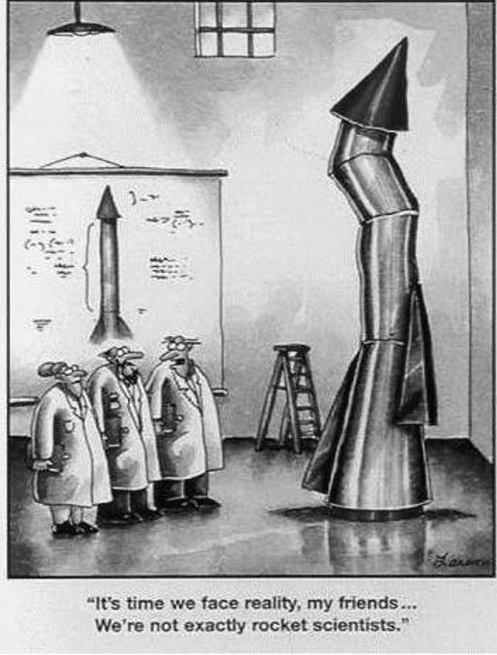
Gary Larson‘s Cartoons
Or scientists behaving childishly

Slide 7
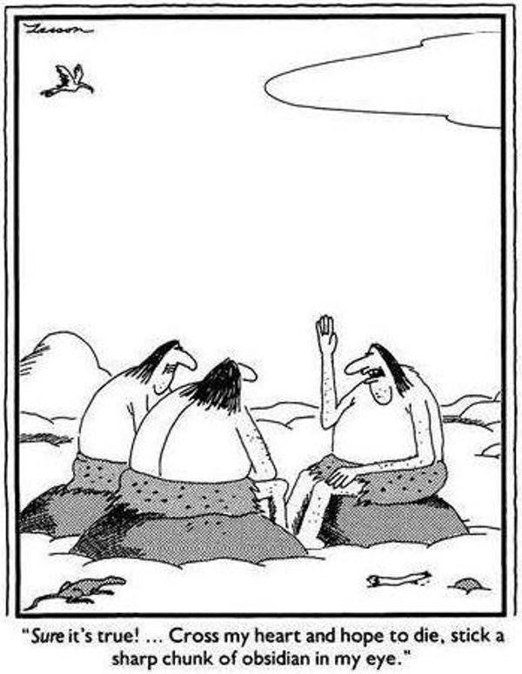
Gary Larson‘s Cartoons
Or stone age subverting our expectation

Slide 8
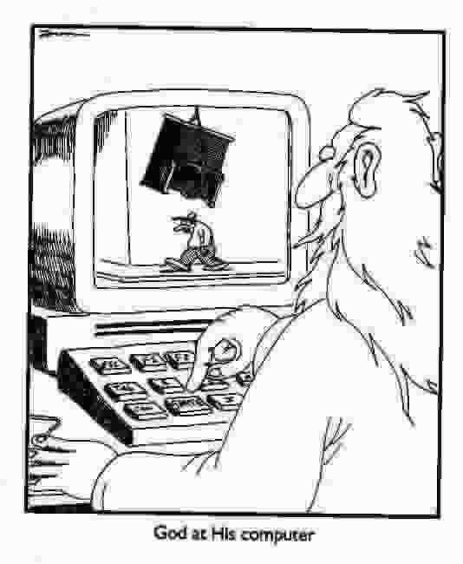
Aim
Different people find different cartoons funny.
Train a deep learning model which encapsulates the subjectivity of humor.
Gary Larson cartoons have each a similar structure and style, which makes them well suited data to learn from.

Slide 9
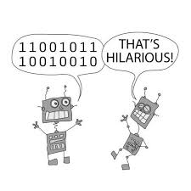
Computational Humor
Computational humor combines the field of artificial intelligence with the research of humor [1]. Make computers understand humor.
Generative or discriminative computational humor.
Trained on a large dataset with some form of funny and not funny annotation.
Notes:
Generative computational humor: E.g.: Synthesizes jokes or puns. Discriminative computational humor:
E.g.: Detect whether a sentence is funny or not.

Slide 10
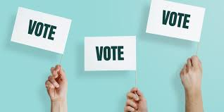
Computational Humor
Problem: These datasets are aggregated over multiple people, which loses the subjective aspect of humor [3].
The resulting models learn what people generally find funny.

Slide 11
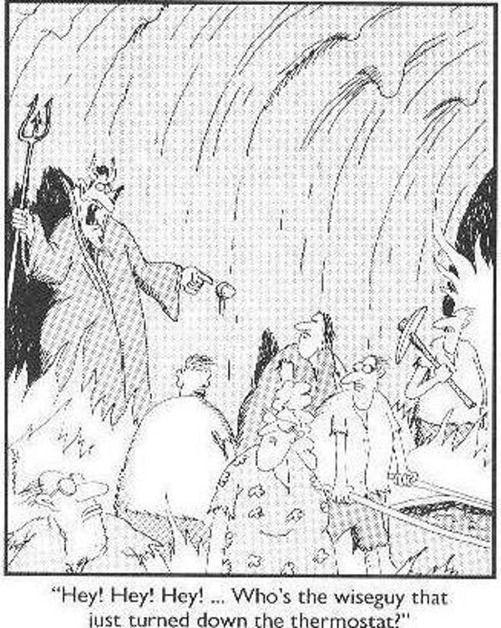
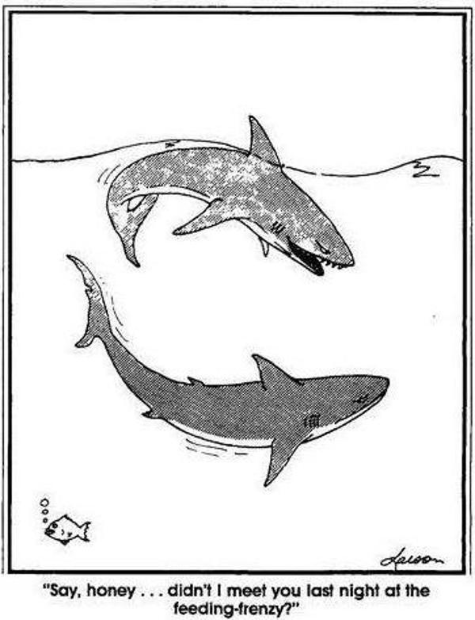
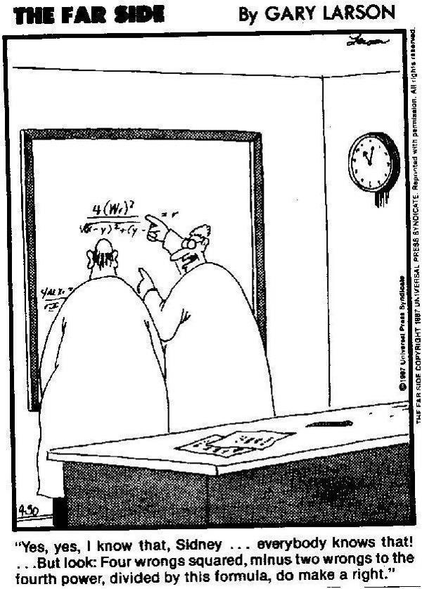
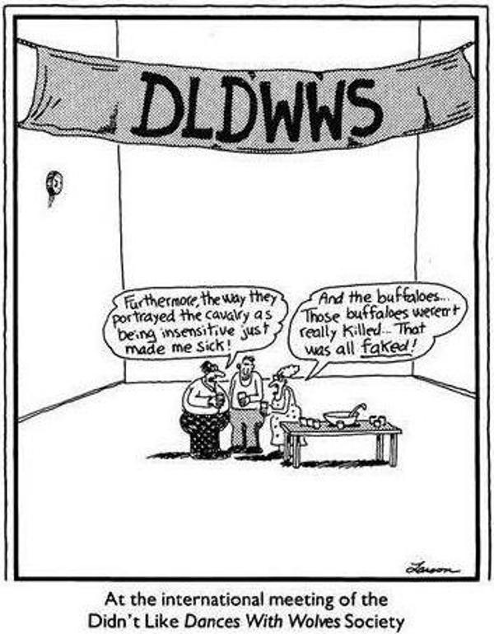
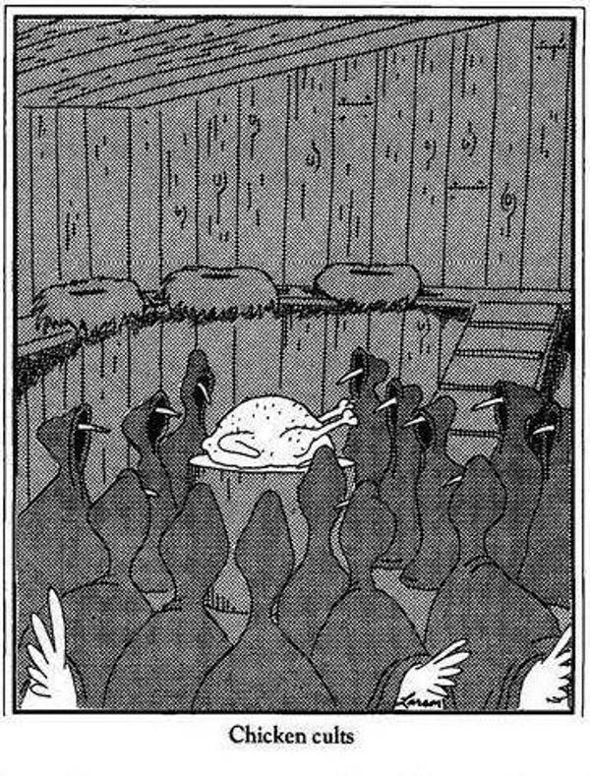
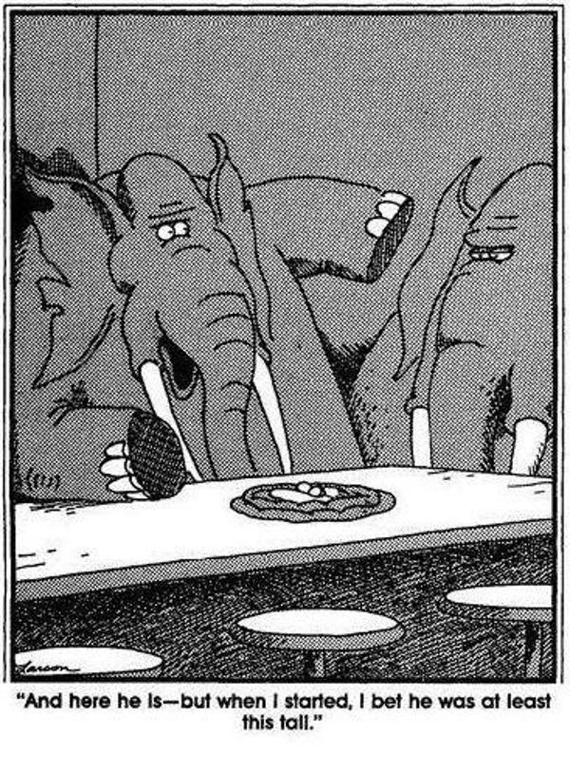
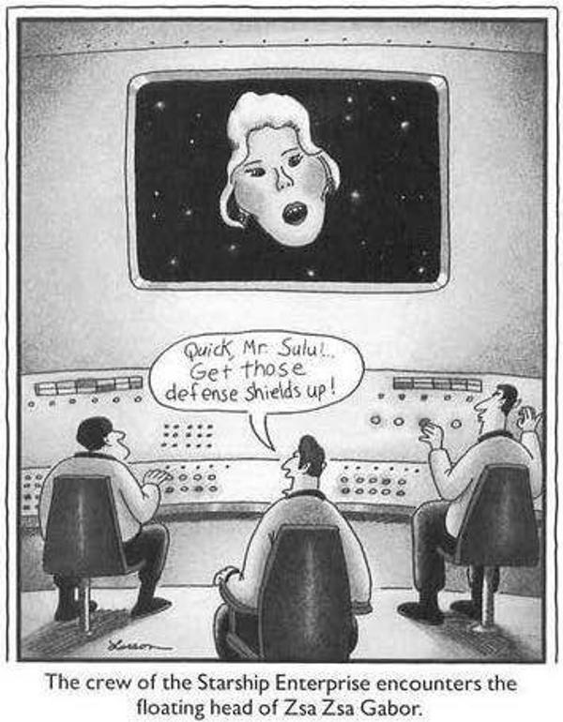
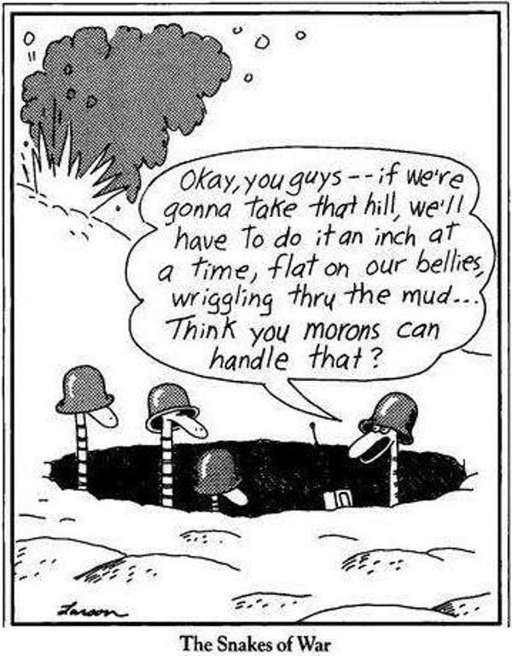
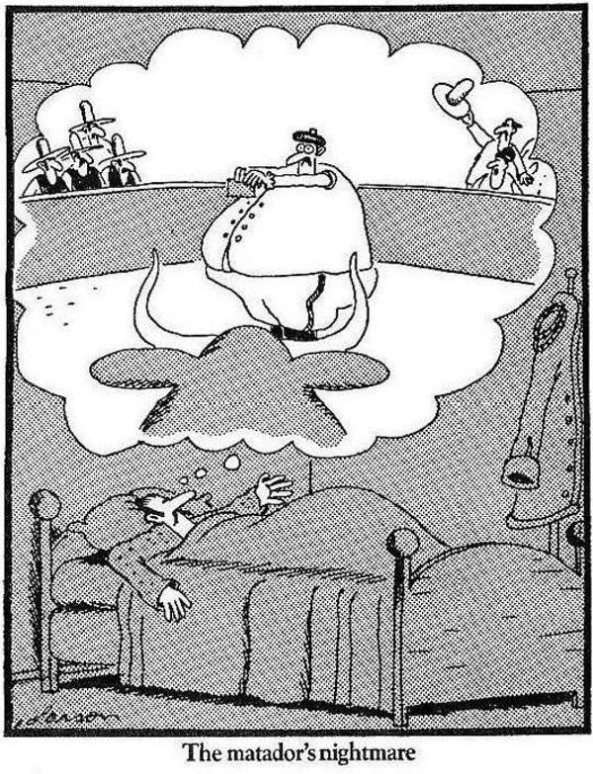
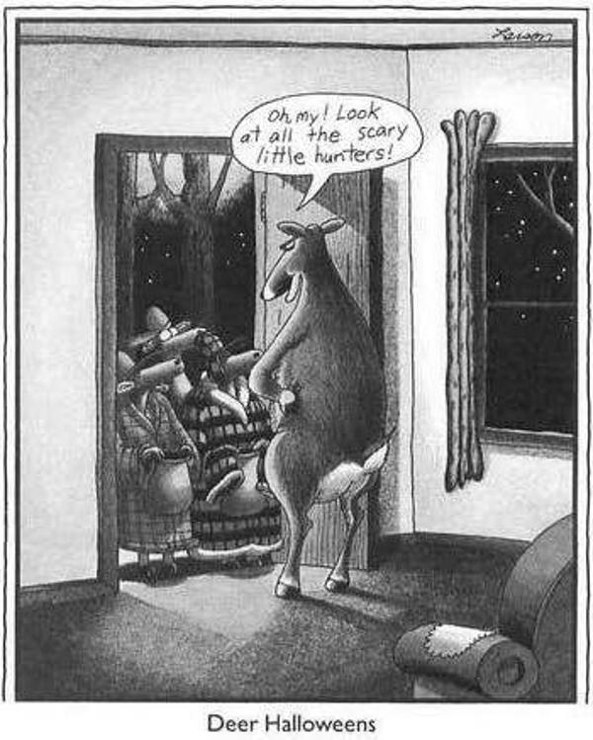
Dataset
There is no humor dataset annotated by a single person.
Novel Gary Larson dataset

Slide 12
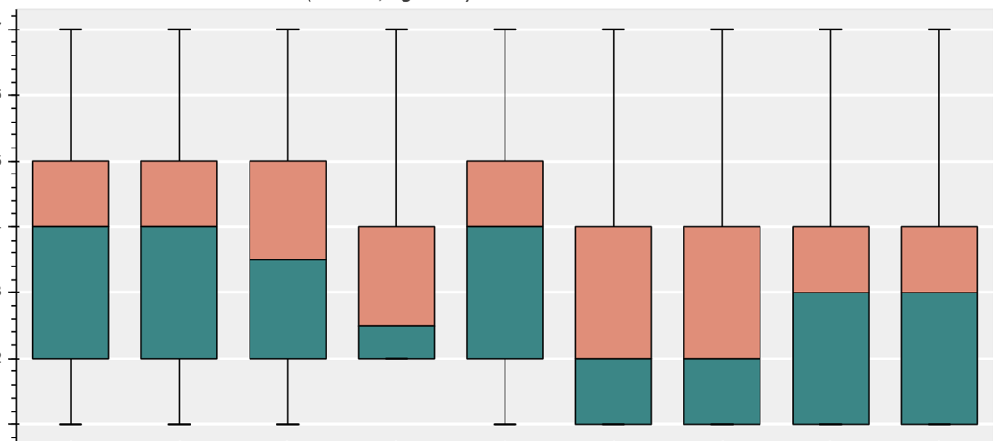
Dataset
Gary Larson dataset
2487 cartoons with ordinal funniness annotation
1 (not funny) to 7 (hilarious)
Annotated by myself
humor fatigue
=> Several months of work (over 300 hours)
Hilarious
Not Funny
Earlier …
… Later

Slide 13
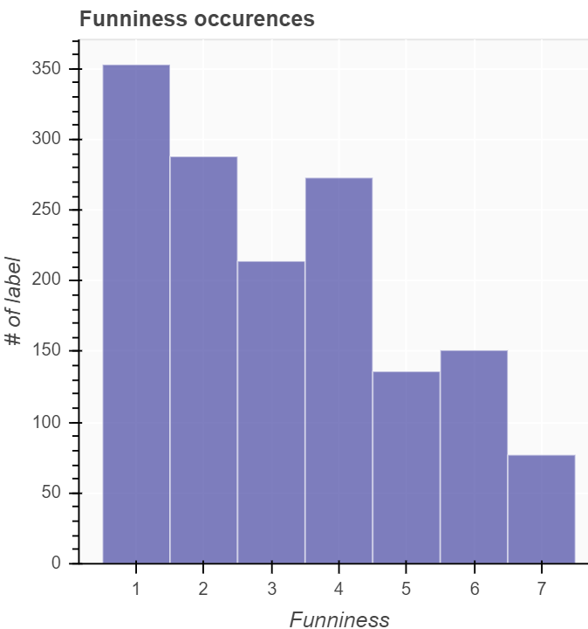
Dataset
Gary Larson dataset
OCR for the punchlines and additional manual adjustments
Custom written annotation application
Data analysis motivated further model development
Notes:
Manual adjustments:
fix typos
Correct orientation of images
Filtered bad examples and duplicates

Slide 14
Approaches
Three different approaches
Visual only: Model based on cartoons
Text only: Model based on punchlines
Visual and Text: Model based on both cartoons and punchlines

Slide 15
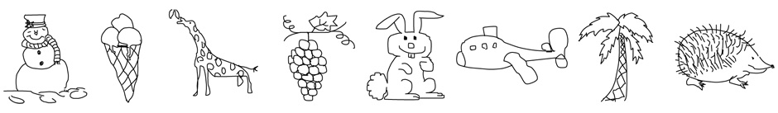
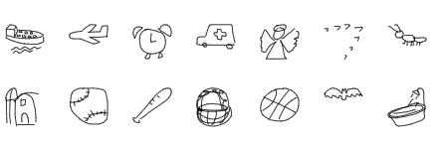
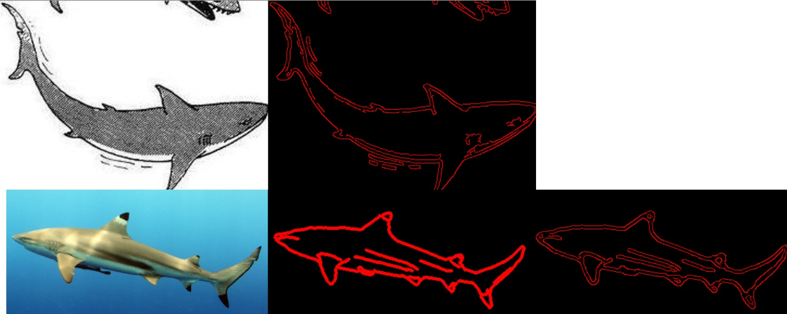
Approaches – Visual only
Apply transfer learning for Convolutional Neural Networks [4].
Real world domain
TU Berlin dataset
Google Quick, Draw! Dataset
Custom filter operation
Object Detection (High-level semantic feature vector)
Notes:
Simple CNNs practically instantly overfitted

Slide 16
Approaches – Text only
Word Embeddings
GloVE [7]
TF-IDF
ELMo [6]
Recurrent architectures [5]
Automated Machine Learning
Sentence embedding
<punchline>
ELMo embedding
LSTM encoding
Fully Connected
Fully Connected
<prediction>
Notes:
GloVE = Global Vectors for Word Representation
ELMo = Embeddings from Languages Models
Sentence Embedding: Take only nouns and average the word embeddings
Take only nouns (as contain most semantic information)

Slide 17
Approaches – Visual and Text
Cascade multiple separately trained classifiers into final regressor
<punchline>
<cartoon>
Autoencoder
ELMo + GloVE sentence embedding
5x5 conv
Fully connected
3x3 conv
concatenate
Fully connected
Feature Extractor
<returns whether input
is in given class>
Fully connected
Notes:
=> Train ensemble of different classifiers for each funniness level
Try to combat class imbalance, low number of training samples and easy combination of text and visual information
Ease use of oversampling
Keep actually trained parts shallow => no vanishing gradient
Fully Connected = FCN + BatchNorm + MaxPool

Slide 18
Approaches – Visual and Text
<punchline>
<cartoon>
Feature extractor
funniness 1
Feature extractor
funniness 2
Feature extractor
funniness 7
…
Fully connected
Fully connected
<funniness 1-7>
Notes:
=> Finally combine into a final regression
Full pipeline (after first feature extractors trained)

Slide 19
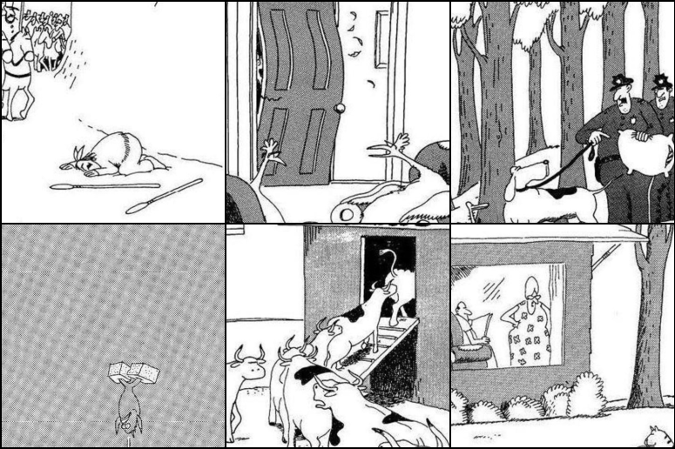
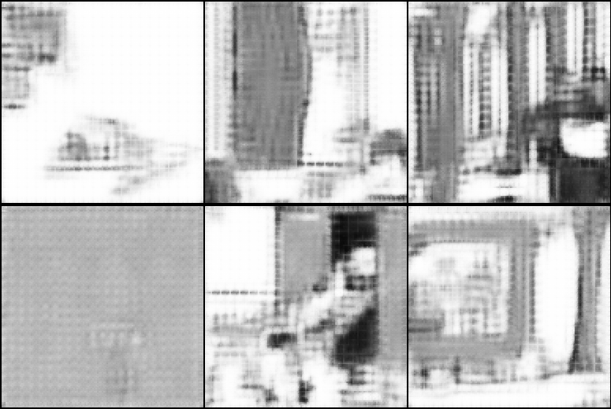
Approaches – Visual and Text
Convolutional Autoencoder [4]
Notes:
* Convolutional Autoencoder with

Slide 20
Results
Experiment | Test MAE | Test Accuracy | Text | Visual
Baseline Most Frequent | 2.26 | 24.50%
Baseline Average | 1.57 | 11.65%
Baseline Random | 2.17 | 13.65%
Simple CNN | 2.26 | 24.50% |  | ✓
Transfer Learning CNN | 1.96 | 24.90% |  | ✓
Transfer Learning CNN (with data augmentation) | 2.01 | 26.10% |  | ✓
ELMo | 1.84 | 25.70% | ✓
AutoML Model with ELMo Vectors | 2.12 | 24.50% | ✓
AutoML Model with TFIDF Vectors | 2.23 | 24.90% | ✓
Two Stage Model | 1.6 | 18.80% | ✓
Two Stage Model with Cartoons | 1.57 | 16.06% | ✓ | ✓
Two Stage Model with Autoencoded Cartoons | 1.58 | 14.46% | ✓ | ✓
Notes:
Baselines best at Mean absolute error, accuracy is transfer learning best
Baselines erklären + MAE erklären

Slide 21
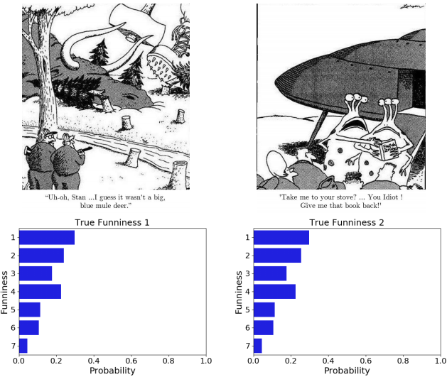
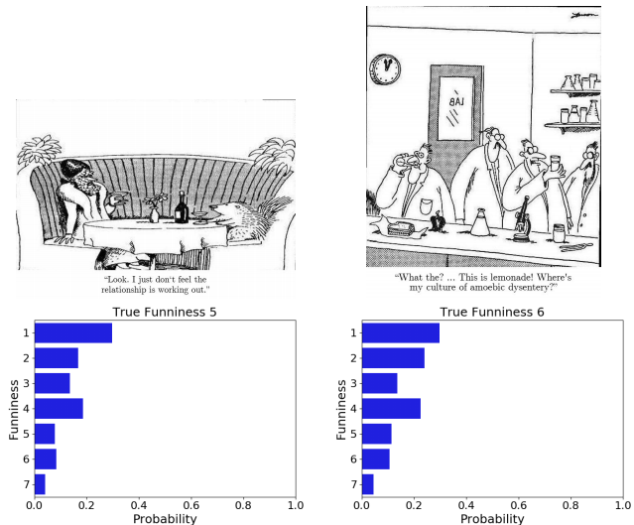

Results
Notes:
Key takeaway: Model learned the label distribution instead of any useful information
Contour/Shape is essentially the same

Slide 22
Reproducibility
Two new datasets:
Future: From myself, annotated 1 year later after initial annotation
Other: From Prof. Eidenberger
Annotation Set 1 | Annotation Set 2 | MAE | Accuracy
Original | Future | 1.08 | 35.86%
Original | Other | 1.67 | 18.70%
Future | Other | 1.53 | 21.21%
Future | Most Frequent | 1.79 | 31.81%
Future | Mean | 1.47 | 12.12%
Other | Most Frequent | 0.61 | 57.57%
Other | Mean | 0.76 | 57.57%
=> Reproducible & subjective
Experiment | MAE | Accuracy
Baseline Most Frequent | 2.26 | 24.50%
Baseline Average | 1.57 | 11.65%
Notes:
Is it even possible for a human to reproduce his/her annotations?
Is humor actually subjective?
Subset with 200 samples
Humor is indeed reproducibile and subjective

Slide 23
Conclusion
"A semantic gap is the difference in meaning between constructs formed within different representation systems.” [2]
Feature representation does not close the semantic gap for subjective humor
Models do not understand, they imitate humor (Clever Hans)
Notes:
A representation system can be e.g. a natural language, a formal language or a proper language within an engineering domain”
Close semantic gap requires new advances in deep learning, or different problem setup:
Less categories to choose from
Transfer Learning more robust
No direct annotation, instead read brain activity directly
They “imitate” humor.

Slide 24
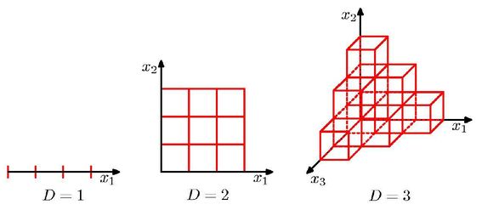
Discussion
Dataset most likely too small.
Curse of dimensionality [4]
Chosen dimensionality reduction measures insufficient
Different approach required, as increasing dataset size infeasible
[8]
Notes:
Training Set: 1492 samples (60%)
Validation Set: 746 samples (30%)
Test Set: 249 samples (10%)
The more parameters a model has (more degrees of freedom), the more data are usually required to train such models. This is why most successful deep learning models are trained on huge datasets, as it is not uncommon for a deep learning model to have several million parameters
Dimensionality reduction through: Word Embeddings (ELMo, Glove, TFIDF, Autoencoder, Convolutional neural networks)
Curse of dimensionality

Slide 25
Sources
Several cartoons by Gary Larson
[1] G. Ritchie. Current directions in computational humour 2001
[2] A. M. Hein. Identification and bridging of semantic gaps in the context of multidomain engineering 2010
[3] P.-Y. Chen and V.-W. Soo. Humor recognition using deep learning 2018
[4] I. Goodfellow, Y. Bengio, and A. Courville. Deep Learning 2016
[5] S. Hochreiter and J. Schmidhuber. Long short-term memory 1997
[6] M. E. Peters, M. Neumann, M. Iyyer, M. Gardner, C. Clark, K. Lee, and L. Zettlemoyer. Deep contextualized word representations 2018
[7] J. Pennington, R. Socher, and C. D. Manning. Glove: Global vectors for word representation 2014
[8] https://www.researchgate.net/figure/Illustration-of-the-Curse-of-dimensionality-showing-how-the-number-of-regions-of-a_fig9_278786166

Slide 26
Thank You for your Attention!
Please feel free to ask any further questions!

Slide 27






Implementation
Python
PyTorch
pandas
NumPy
scikit-learn
hyperopt-sklearn
AllenNLP
django

Slide 28
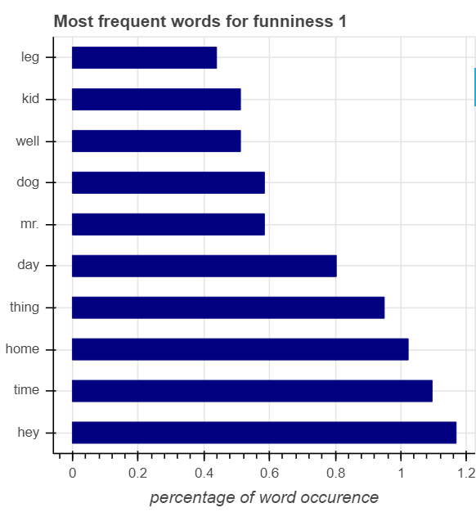
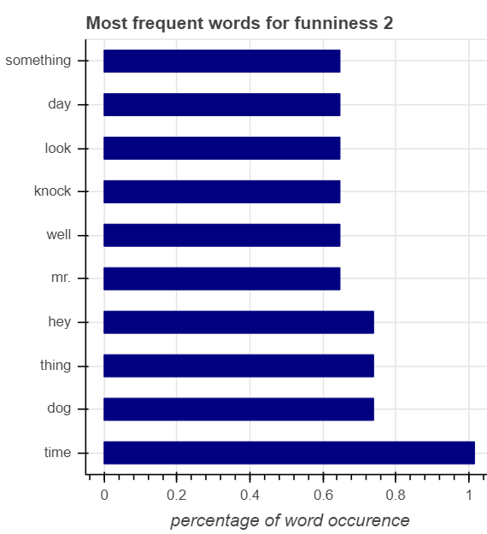
Data Analysis

Slide 29
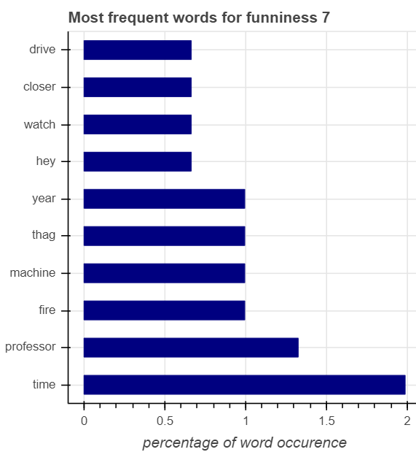
Data Analysis

